Slide 1


The Impact of AI on Student’s Grades Compared to Their Actual Skills
Ev(11
Judika Ompusunggu (11S25044)

Slide 2










How Student use AI in Daily Learning?
ChatGpt
Write an Essay
To Do Assignments
Summarize the Material
Ask Questions That They Don’t Understand

Slide 3




POSITIVE IMPACT OF AI
Improve Learning Efficiency
Helps Understand Complex Concepts
Personalized Learning
Help Ideas and Creativity
AI can help search from various learning sources without having to search manually.
AI can provide analogies and illustrations until students understand.
AI can adapt the way students use it
AI can help students get initial ideas and develop them

Slide 4



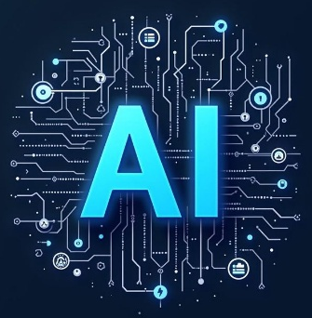

Ai IMPACT TO STUDENTS GRADES VS SKILL
2
4
1.AI INTRODUCTION
3.AI DEPENDENCY
Students begin to learn about AI and use it
Students are lazy to think
2.GRADES INCREASED
4.DON’T HAVE ANY SKILLS
1
3
Student feel the positive impact of AI
Students feel frustrated with their lack of skills

Slide 5

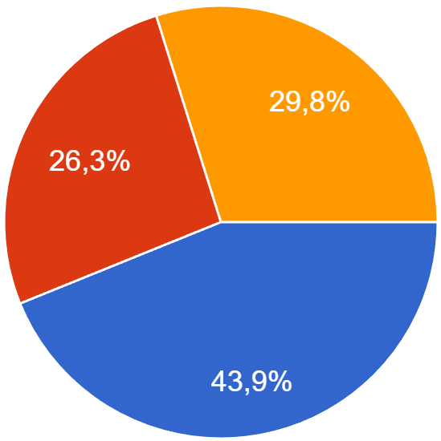

Survey in Informatics Class
1.I am depending on AI when completing assignment.
58 Answer
DATA

Slide 6
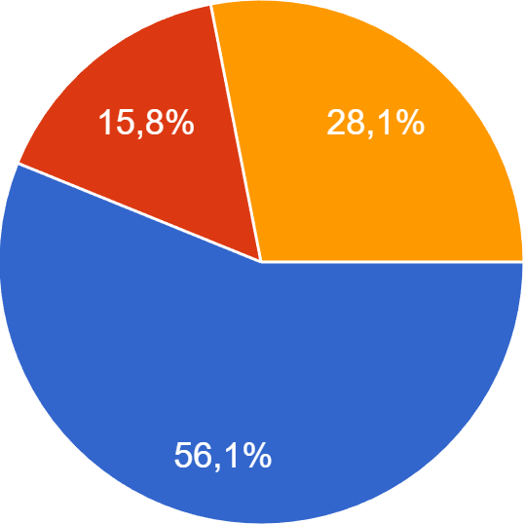

Survey in Informatics Class
2.AI is improving students grades.
58 Answer
DATA

Slide 7
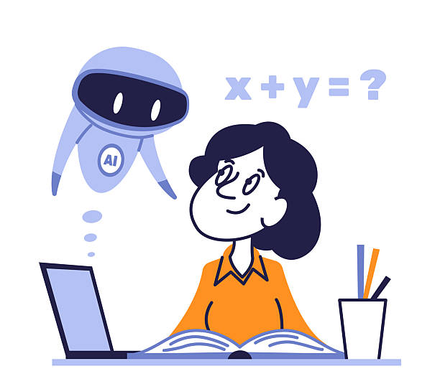
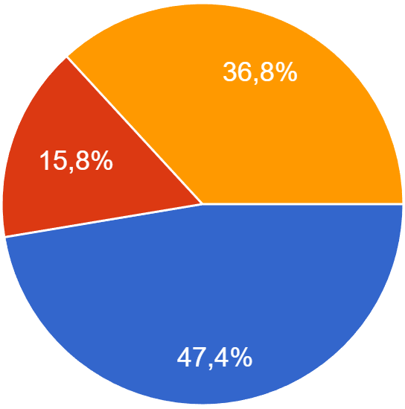
Survey in Informatics Class
3.AI increase my grades but not my skill
58 Answer
DATA

Slide 8
Answer 1: I use AI because the time inside the class is limited. Sometimes there are interactive questions that cannot be explored during class, so I use AI to understand those problems more deeply.
Answer 2 : I need to set a mindset that I shouldn’t depend on AI, because if I rely on it too much, I will lose my critical thinking. The way I avoid that is by limiting what I use AI for. I shouldn’t use AI to answer everything.
Answer 1: I use AI to answer questions I might get after class, as my wild ideas often comes to me after class.
Answer 2: I don’t relay on AI but I use it because it can provide answer quickly.
Answer 1: I only use AI and only if I didn’t understand my lesson completely by the time I was learning it during class.
Answer 2: The simples solution to that problem would be to not use AI at all, if is AI function ability that may some so good in a first place then the best Way to not get dependent on something like AI is to not use them all.
Zaki
Dillon
Amazia
Question 1: Why do you use AI to explain lessons? Doesn’t your lecturer explain them clearly enough?
Question 2: How do you use AI without becoming dependent on it?
INTERVIEW

Slide 9
COMPARISON
1
2
Zaki and Amazia both use AI after class, while Dillon only uses it when it is truly necessary. Amazia provides the most complete explanation regarding the limited time in class, whereas Zaki focuses more on the new ideas that appear afterward.
Dillon chooses an approach that avoids using AI, Zaki uses it in a practical way without a clear strategy, and Amazia shows the healthiest and most balanced way of using AI by developing a mindset that does not depend on it.
From the three respondents, it can be concluded that all students use AI as a learning tool, but with different approaches.

Slide 10
CONCLUSION
AI can indeed assist students in learning, potentially leading to improved grades. However, there are certain cases where students become dependent on it. Therefore, what's needed is responsibility in using and utilizing it.
Thank You
Q&A?

